Slide 1
Angular Expressions

Slide 2
What is Angular Expression?
Expression in Angular are used to bind application data to HTML. The expressions are resolved by Angular and the result is returned back to where the expression is written.
The expressions in AngularJS are written in double braces: {{ expression }}

Slide 3
Features of Angular Expressions
Angular expressions are evaluated against a scope object.
expression evaluation is forgiving to undefined and null.
Control flow statements cannot be used in angular expressions, i.e, loop, conditional, or exception.
Angular Expressions do not allow function declaration.
In an Angular expression, Bitwise or void operators cannot be used.
Angular expressions can work with filter.

Slide 4
Angular Expression Example
{{ 5+5 }} this will return 10
{{ firstName+” “+lastName }}. If firstName is “Rohit” and last name is “Shetty” , then the expression will return Rohit Shetty.
{{ getMessage() }} or {{ add(4,5) }} will return some text and 9.

Slide 5
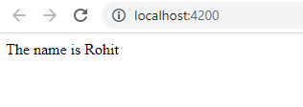
Angular Expression Example
1. String Expression:
<div>
The name is {{name}}
</div>
name="Rohit"
app.component.ts
app.component.html

Slide 6
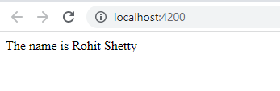
Angular Expression Example
1. String Expression:
app.component.ts
<div>
The name is {{firstName+ " "+ lastName}}
</div>
firstName="Rohit"
lastName="Shetty"
app.component.html

Slide 7
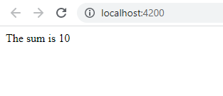
Angular Expression Example
2. Number Expression:
<div>
The sum is {{5+5}}
</div>
app.component.html

Slide 8
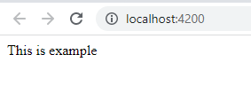
Angular Expression Example
2. Calling component Method(string):
app.component.ts
<div>
{{getMessage()}}
</div>
getMessage():string{
return "This is example";
}
app.component.html

Slide 9
Angular Expression Example
2. Calling component Method(string):
app.component.ts
<div>
{{getMessage()}}
</div>
getMessage():string{
return "This is example";
}
app.component.html

Slide 10
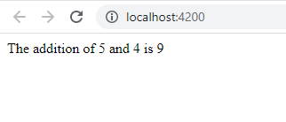
Angular Expression Example
2. Calling component Method(number):
app.component.ts
<div>
The addition of 5 and 4 is {{add(5,4)}}
</div>
add(a:number,b:number):number{
return (a+b)
}
app.component.html

Slide 11
Expressions with Data-Binding
The data binding can be useful technique for many applications
The ngModel directive helping the expression to accept inputs and evaluate then and finally embed into the browser.

Slide 12
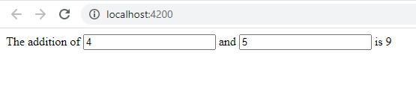
Expressions with Data-Binding
Addition of two numbers without function
app.component.html
<div>
The addition of <input type="number" [(ngModel)]="num1"> and <input type="number" [(ngModel)]="num2"> is {{ num1+num2 }}
</div>
num1:number=0;
num2:number=0
app.component.ts

Slide 13
Expressions with Data-Binding
Addition of two numbers using function
app.component.html
app.component.ts
<div>
The addition of <input type="number" [(ngModel)]="num1"> and <input type="number" [(ngModel)]="num2"> is {{ add(num1,num2) }}
</div>
num1:number=0;
num2:number=0
add(a:number,b:number):number{
return (a+b)
}

